Slide 1
LESSON 7: PLANNING FOR INSTRUCTION
Instructional Planning

Slide 2
Simply means planning to effectively execute an instruction
In education, Instructional Planning means to visualize and forecast into the future of what, why, and how of the teaching learning process (Zulueta, Francisco)
“Why”- Needs analysis of what to be done/learner’s needs
“What”- formulate objectives and evaluation procedures
“How”- Selecting methods and procedures for doing

Slide 3
Why Instructional Planning?
Provides direction to the teacher, students and all stakeholders
Develops an insight about the broader educational goals
Reduces probability of making mistakes or losing focus
Economizes on efforts, cost and time of teachers/students
Provides feedback to teachers on performance and baseline for reviews of teaching-learning

Slide 4
Key Components of Instructional Planning
Clear Learning Objectives
Well defined Instructional Methods and Techniques
Well defined Assessment and Evaluation Methods
Well time and paced, and flexible instruction methods
Well defined lecture structures
Instructional planning that creates room for reflection and revision
Well defined classroom rules, regulations and routines

Slide 5
Instructional Planning is key to successful teaching learning process
Effective instructional planning helps create a structured learning environment, supports student engagement, and enhances overall educational outcomes.
Instructional planning is a bi-polar process where teaching must lead to learning.

Slide 6
Steps involved in Instructional planning

Slide 7
Prior to each lesson, unit, semester, or school year, teachers plan the content of instruction, select teaching materials, design learning activities and grouping methods, decide on the pacing and allocation of instructional time, and identify learning opportunities for students.
Instructional planning entails several key steps to ensure effective teaching and learning

Slide 8
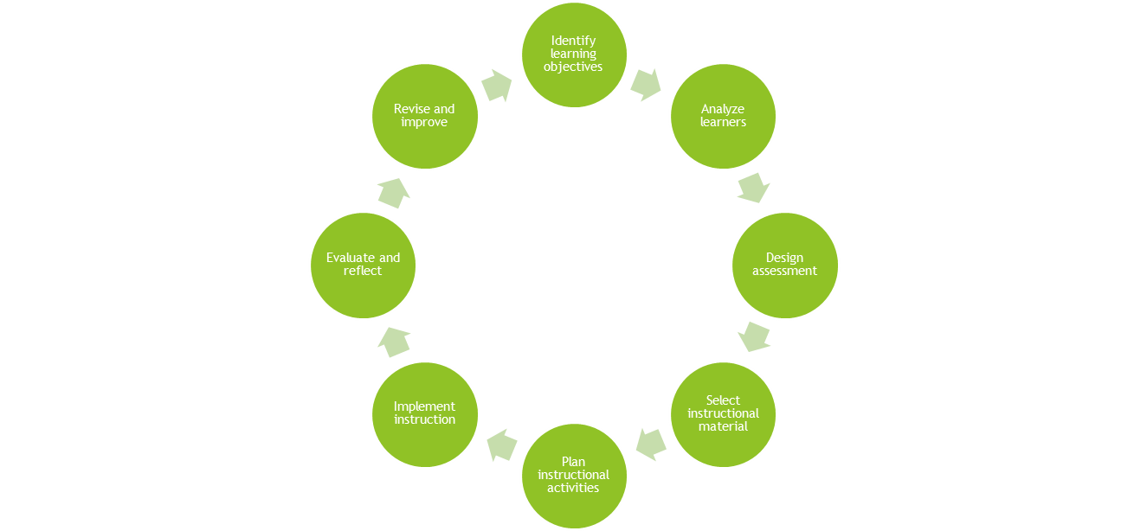
KEY STEPS IN INSTRUCTIONAL PLANNING
1. Identify learning objectives
2. Analyze learners
3. Design assessment
4. Select instructional material
5. Plan instructional activities
6. Implement instruction
7. Evaluate and reflect
8. Revise and improve

Slide 9
KEY STEPS IN INSTRUCTIONAL PLANNING CONT’
1. Identify learning objectives:
Defines what the student needs to know at the end of the lesson/unit
The objective should be SMART; clear, specific, measurable…..
2. Analyze learners:
Understand leaners back ground, needs and prior knowledge of students
Helps in tailoring instruction to their level and interests

Slide 10
STEPS IN INSTRUCTIONAL PLANNING CONT’
3. Design assessment:
Plan how to measure students progress towards the learning objective
This includes quizzes, RATS, assignments, projects or observations
4. Select instructional material:
Select learning material that support your objective
Material and resources such as text books, videos, journals and online resources

Slide 11
STEPS IN INSTRUCTIONAL PLANNING CONT’
5. Plan instructional activities:
Develop lesson and activities that align with the objectives that engage students in learning
This includes planning the sequence and timing of activities
6. Implement instruction:
Deliver the lesson according to planned lesson and activities keeping time lines
Students responses be the controlling factor in lesson delivery and adjust according to their needs

Slide 12
STEPS IN INSTRUCTIONAL PLANNING CONT’
7. Evaluate and reflect:
Assess the effectiveness of the instruction and the students understanding
This level evaluates the lecturer and the student
The above information is used to make adjustments for future lessons
8. Revise and improve:
Based on the evaluation and reflection information ,make necessary changes and adjustments to improve the instructional plan for next time.

Slide 13
Content Analysis
Content analysis means breaking the content into its constituent parts.
A scientific and systematic planning of instruction enables the teacher to be fully in command of the system rather than be commanded by it.
The teacher has to utilise his/her imagination, creativity and insight while following the steps of planning instruction.

Slide 14
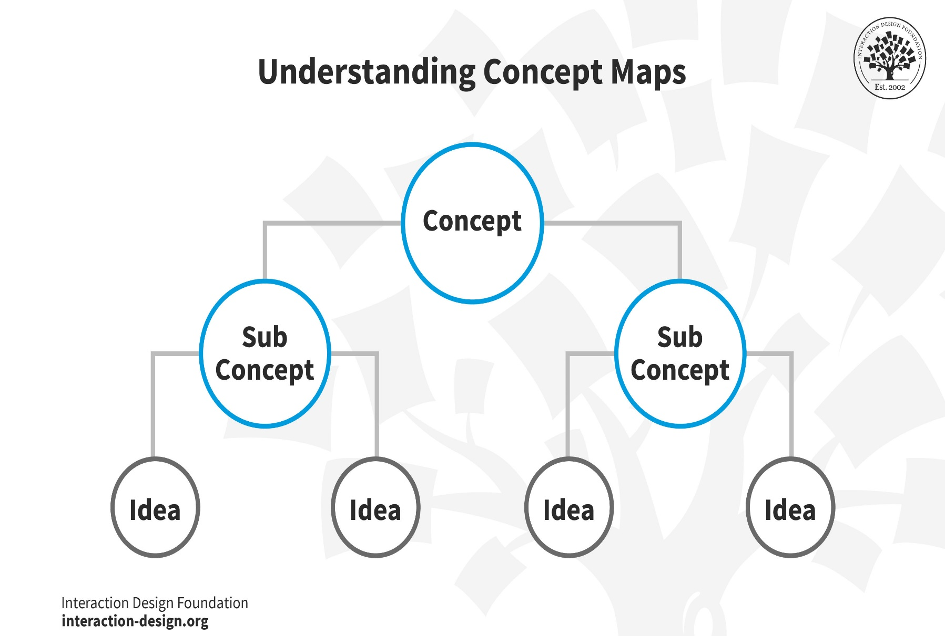

Slide 15
Educational and learning
Knowledge does not respect any boundaries.
Any topic can be extended beyond its limits.
The teacher has to keep in mind the educational and learning needs of students.
He/she has to delimit the contents to be taught.
The teacher has to properly analyses the content to be taught to the students.

Slide 16
Organizing the Content
The teacher must:
identifies topics given in the curriculum,
breaks these into their constituent parts,
arranges all these in a hierarchical sequence,
refines and limits the topics.

Slide 17
Syllabus Does Not Prescribe Content
A syllabus is only an indication of the prescribed content and does not prescribe the order in which topics should be taught.
The teacher therefore, has to reconcile the dictates of the syllabus with the educational and learning needs of the students

Slide 18
Instructional Objectives
The teacher has to take up the instructional objectives one by one and analyse the related content accordingly.
He/she takes up a topic and lists all the relevant subject material and ensures that it is technically accurate and up-to-date.
He/she later on breaks the topic into small constituent sub-topics and their elements, and ensures that the elements included in the sub-topics are a part of the main theme/topic.
He/she must identifies the topics according to the needs and interests of the students.

Slide 19
Elements and Sub-topics
Some of the elements and sub-topics may be dropped because they deal with everyday knowledge.
Such sub-topics need not be taken up for instruction.
Similarly, a teacher may not like to take up certain elements or sub-topics because these do not match the mental level and age of the students and are therefore, inappropriate.

Slide 20
Limits of the Topics to be Learned
Once the subject matter has been identified, the next step is to refine and mention the limits of the topics that the students are required to learn and to ensure that the topic as self-contained, as possible.
The same content may be taught at various levels but the details and the treatment of the content is determined by the level of teaching a particular class of students.

Slide 21
Example:
Under the topic 'Personality Assessment' involves projective and non-projective techniques and under each heading there are a large number of techniques.
The teacher will have to specify which techniques should be include, and what particular technique he/she would like to take up with the given class.
Again, for each particular technique the teacher will mention the limits of study i.e. characteristics of the techniques and utility for psychoanalysis’s
All these things help in refining and limiting the content according to the needs and interests of students.

Slide 22
Planning and management of Instruction
Flow charting the content
After deciding the topics and limiting the scope of the topics, the teacher is required to arrange these into some type of natural sequence.
the sequence should be completely logical from the point of view of the subject material.
Each element should be linked with the next element and these should form a part of the main topic.

Slide 23
Flow Charting the Content
Sequencing the topics should be based on maxims of learning like 'known to unknown‘ or 'simple to complex‘.
This should be based on a teacher's experience, intuition and own learning experiences.
After this, the teacher may needs to make or develop a flow chart of the content.
This helps in making a global picture of the whole content in the mind of the teacher as well as students.

Slide 24
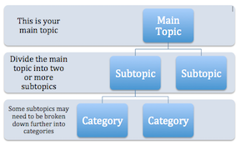
Flow Charting the Content

Slide 25
Flow Charting Topics
Flow Charting topics increases the probability that logical sequence is psychologically valid and presents a graphic view of the inter-relationships among various sub-topics and elements.
The construction of a flow chart helps the teacher give proper focus to the work to be done in the unit.
While organisation of the main concepts in the structure of a unit may take many forms, such organisation is essential if learners are to understand how parts of a unit relate to each other and also what the focus of their study is, at any given time.

Slide 26
Selecting Suitable Presentation Mode
Before entering the class the teacher may contemplate questions like:
What is the best way to go about teaching each topic?
What methods should be used?
What teaching strategies are possible and more suitable'?
Questions like these and many others will arise in the teacher's mind.
Answers to such questions are many and depend upon the criteria fixed by the teacher.

Slide 27
Criteria for selecting presentation mode
A large number of criteria determine the presentation mode, these includes:
the nature of instructional objectives,
subject matter,
background of students,
learning strategies adopted by them and
style of teaching

Slide 28
Instructional objectives
To achieve the instructional objectives in the teacher’s mind during the teaching-learning process, the teacher may like to follow a particular mode of presentation.
Subject matter
The nature and structure of the subject matter that the teacher intends to handle decides the mode of presentation.
Student's background
The teacher's own experiences guide him about estimating the abilities of the students and
organising instruction accordingly.

Slide 29
Students' Aptitudes
Teachers who underestimate the abilities of their students, or those who overestimate students' aptitudes follow approaches that do not recognise the students' ability to learn.
The teacher should ensure that the selected mode of instruction enables the students to process the presented information meaningfully and adequately.
The presentation mode selected should not lead to conflicting situations for his students.

Slide 30
Teacher's teaching style
Any instructional method that a teacher adopts in the classrooms must conform to his/her personal style of teaching.
Large group-instruction, may not appeal to those teachers who prefer to work closely with students.
A teacher should analyse his/her own particular style of teaching for planning instruction

Slide 31
Selection of Media
Selected media may motivates the learners and make the process of teaching and learning easier and more effective.
Some media suitable for classroom use are computer, interactive video, Motion pictures and Power point
The most important and challenging task before the teacher is to select the media or medium that is effective for supporting the teaching-learning process.

Slide 32
Decision about the media
This decision about the media to be used in the classroom is dependent upon thorough knowledge of:
what is to be taught;
how it is to be taught;
How its effectiveness can be tested;
who the learners are; and
Ability of the teacher to operate the hardware used with the selected media.

Slide 33
Coordinating Media with Teaching Methods
After taking decision about the media, another question that engages the mind of the teacher
is "What type of media are to be used and for what type of learning activities?”
For example,
Audio visual aid is more effective for verbal information, while live demonstrations are more effective for developing psychomotor skills.

Slide 34
Linking the Content to the Media
The instruction to be given through the media has to be an integral part of the instructional system.
The content to be taught through the media must be linked with the content taught through other modes of presentation.
Otherwise it may confuse the students and they may feel that some unfavourable conditions are being created which may prove to be a handicap.

Slide 35
Media should be complementary to Instruction Method
The instruction given through the selected media has to be integrated with the teaching methods used by the teacher
The content being covered through a particular medium has to be so linked with the content being taught through a particular method so that both are integrated with each other.
Example:
the teacher may be using lecture method in the class to teach some unit or part of the unit and may supplement the teaching by using audio visual to teach another part of the unit.
Media should be complementary to the major instructional method being - used by the teacher.

Slide 36
Detailing the Task
After analysing the content to be taught to the students and selecting the suitable presentation mode and the appropriate media, the teacher must define the tasks to be performed by taking up each objective and writes down:
the content to be covered for achieving it,
the method or strategy to be used to teach the content and
the media that will be utilised for teaching

Slide 37
Considerations Detailing the Task
Each detail is written out based on the following of Instruction considerations :
What does the teacher want the students to do, to demonstrate that they have learnt the topic?
What questions does the teacher expect the students to answer?
What tasks, procedures and techniques does the teacher expect the students to perform and at what level will this be executed'?
What total changes in the students' behaviour is expected and in what form can it be observed and measured?
What role will the teacher perform in order to bring about desired changes in students‘ behaviour'?
What media will be utilised and at what particular time so that the desired outcomes are achieved?
What instructional modes will be used to take the best advantage of the existing situation'?

Slide 38
Relevance of instructional system
In this way the teacher:
describes,
analyses and
reviews
the relevant instructional system within which the tasks are to be performed.
The tasks are the action points that the teacher will take into account while teaching

Slide 39
Presentation Modes used to transact assigned curricular content

Slide 40
Key Aspects
The most important and challenging task before the teacher is to select the media or medium that he/she would like to use in the classroom and use it effectively for supporting the teaching-learning process.
The choice of the medium/presentation mode is dependent on what is to be taught, how it is taught, how its effectiveness can be assessed, who the learners are and the teacher knowledge and skills on media operation
The content being covered through a particular medium has to be so linked with the content being taught through a particular method that both are integrated with each other to avoid confusion. Media should be complementary to the major instructional method being

Slide 41
Presentation mode | Example | Applicability
Visual Aids | Slide shows Charts and Graphs Infographics | Using PowerPoint to create slides with key points, images, and diagrams. Displaying data visually to help students understand statistical information Combining images, text, and data to present complex information in a simplified
Interactive Technology | Smartboards Educational Apps and Software | Interactive whiteboards that allow for dynamic presentations and student interaction. Tools that provide interactive simulations, games, and exercises to reinforce content.
Multimedia Presentations | Videos Animations | Short educational films or clips that illustrate concepts or provide real-world examples Animated sequences to explain processes or complex ideas in a visually engaging way.

Slide 42
Examples of Presentation Modes
Computer
programmed text
Interactive video, motion pictures, slides,
TV cassettes, filmstrips, printed texts,
Training aids,
Audio-charts.
Over-head projection slides

Slide 43
Role of teacher while selecting methods, instructional media and evaluation mode

Slide 44
Teacher as planner - Transacts curriculum in classroom - Planner of instruction with close interaction with students - In the transaction, teacher decides method, instructional design and media - Emphasizes certain parts of curriculum, students handle the rest

Slide 45
Choice of teaching method Teaching methods - means Variables based method selection - Variables include: selection of materials, grouping patterns, grading, classroom organization and student behavior - The variables trigger variations in daily learning experiences - Diverse teaching methods enables teacher to handle a diversity of students

Slide 46
Choice of teaching method continued Learning environment based method selection - Methods classified as: structured, interactive, self directed and computer assisted. -Most conventional methods (lecture, didactic questioning, assigned textbook reading) – structured

Slide 47
Choice of teaching method continued - Interactive method – Student involvement in designing and implementing learning. - There is some form of discussion between teacher and students. - Interactive methods promote freedom, trust and responsibility among students

Slide 48
Choice of teaching method continued - Self-directed method (include project, independent study, computer-based instructions etc.) - Students take up learning with minimum teacher direction and control - Students learn ‘how to learn’ - Technological advances have brought the world to the classroom.

Slide 49
Choice of instructional media - Done after drawing out prior knowledge, experience, level of sophistication etc.. Of students. - Oldest media is chalkboard - Technological advancements have brought new media - Categorization of media – non-projected, projected, visual, audio and electronic.

Slide 50
Choice of instructional media continued - Non- projected – allow teacher to stimulate students. - Projected visuals – gives universal perception to students and free teacher from being the direct medium of delivery. - Audio media – use of listening to support teaching-learning process. Act of listening is more controlled than that of audio-visual.

Slide 51
Choice of Evaluation Mode - Evaluation – Done using tests - Testing – to individualize instruction, place to higher grade and monitor progress. - Testing – grouped as norm-referenced tests, criterion-referenced tests and informal evaluation measures.

Slide 52
Choice of Evaluation Mode continued - Norm-referenced tests – differentiate individuals or schools along a continuum. - Rank order of achievement from high to low. - Teacher-made tests – help teachers in making routine classroom decision. - Criterion-referenced tests – designed to check if students can perform a particular task(s), e.g. drawing maps

Slide 53
Choice of Evaluation Mode continued - Other modes of evaluation include: - Observation of student’s interaction and behavior – assess students’ progress, information level, interests, attitudes etc. - Analysis of students’ work samples e.g. writing, painting, drawings etc. - Self-reporting – students discuss or write their problems, progress etc.

Slide 54
Choice of Evaluation Mode continued - Most suitable mode is selected according to the teachers’ objective. - All the modes help teacher to make decisions regarding placement, diagnosis and plan for further learning environment.

Slide 55
THE END…

